Slide 1
Quickly Finding Common Ancestors Through DNA
Ballroom B
Rob Warthen
www.dnagedcom.com/RootsTech

Slide 2
Please silence all electronic devices
No audio or video recording
Photos allowed

Slide 3
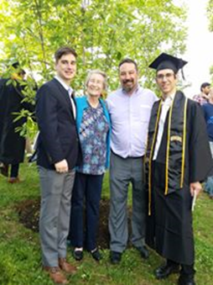
Who am I?
Just a guy who enjoys Genealogy and Computers
Been working with DNA and Genealogy tools since 2011
One of the Cofounders of DNAAdoption and mitoYDNA
Adoptee and Brick Wall advocate
Computer Programmer
Long time IT server/network experience
Worked at Nasdaq with Big Data before Big Data was a word

Slide 4
Why I do this
My wife is an adoptee
Her mom asked me to help her find her birth family
I saw the need to make getting data easy
I believe your data is your data
I believe that you don’t need to share your data if you don’t want to, but if you do, you should be able to do so in a secure way

Slide 5
Back to Basics

Slide 6
4 Types of DNA
Autosomal
Autosomal DNA is a term used in genetic genealogy to describe DNA which is inherited from the all 22 chromosomes and from both parents.
mtDNA
DNA passed down from Mothers to their Daughters and Sons.
X DNA
X DNA is one of the 23 Chromosome. Father passes their X fully intact to their Daughters. Mother’s pass their X recombined to their daughters and sons. Can be useful in following specific inheritance patterns, but be careful as you see later.
Y DNA
DNA passed from father down to son. Can be traced more distantly. Since fathers often pass their surname down to sons, it is helpful for tracing surnames.

Slide 7
Other Terms
centiMorgans (cMs)
A centiMorgan (cM) is a measurement of how likely a segment of DNA is to recombine from one generation to the next. A single centiMorgan is considered equivalent to a 1% (1/100) chance that a segment of DNA will crossover or recombine within one generation. For humans one million base pairs (bp) average about one centiMorgan. However the rate of recombination is highly variable.

Slide 8
Other Terms (continued)
In Common With (ICW) or Shared Match
When two matches are ICW with each other. This can then be used to semi triangulate your match (find their common ancestor which is likely your common ancestor too IF the two ICWs also match each other).

Slide 9
Other Terms (continued)
Most Recent Common Ancestor
The most recent common ancestor is the first or closest ancestor you share with a DNA match or relative. All the ancestors of your MRCA are known as Common Ancestors because they are further back in time or less recent.

Slide 10
Other Terms (continued)
Overlapping Segment
When two matches have the same or close to the same amount of DNA on a single chromosome.
Triangulation
Triangulation happens when the two matches with an Overlapping Segment ALSO match each other on that same segment.

Slide 11
Autosomal Testing Growth

Slide 12
DNA Company Features (Well ones important to Finding Common Ancestors)
DNA Company | Matches | Segments (Chromosome) | Shared Matches | Family Tree
Ancestry | X |  | X | XX
FTDNA | X | X | X | X
GEDmatch | X | X | X | Limited
Living DNA | X | Coming Soon | Coming Soon
My Heritage | X | X | X | XX
23andMe | X | X | X | Limited

Slide 13
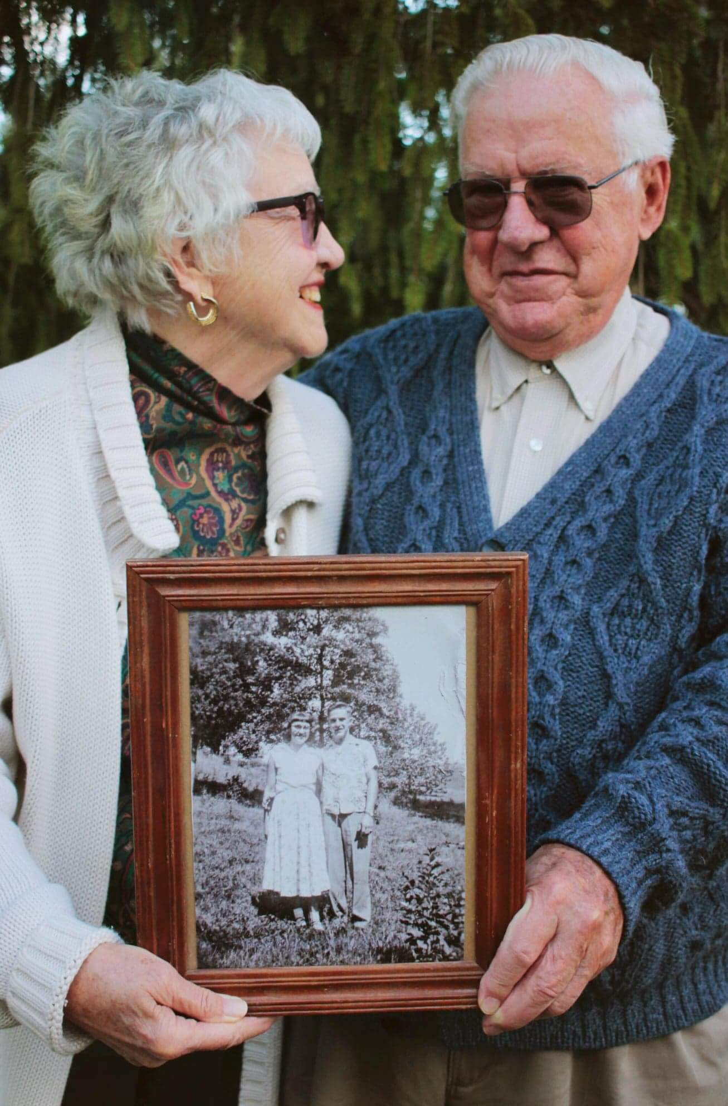
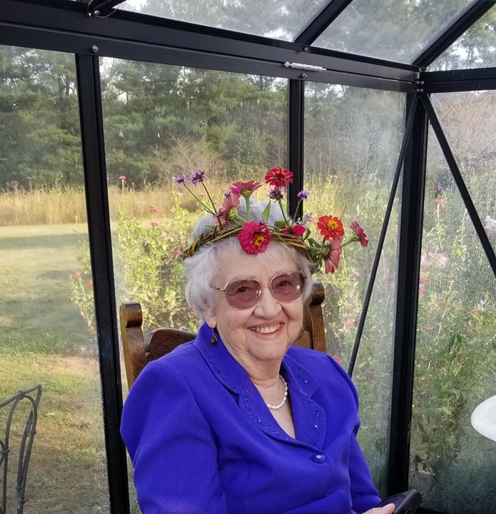
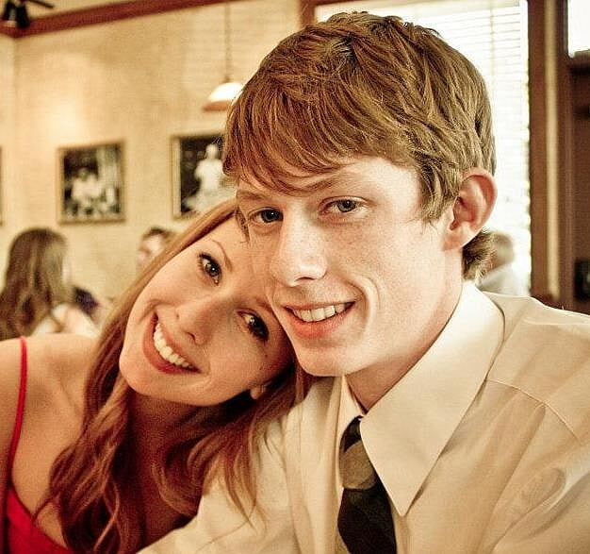
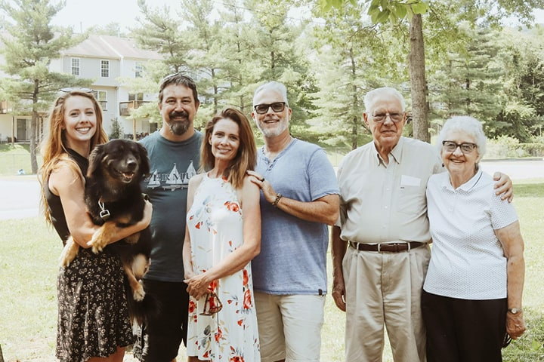
Finding Sue

Slide 14
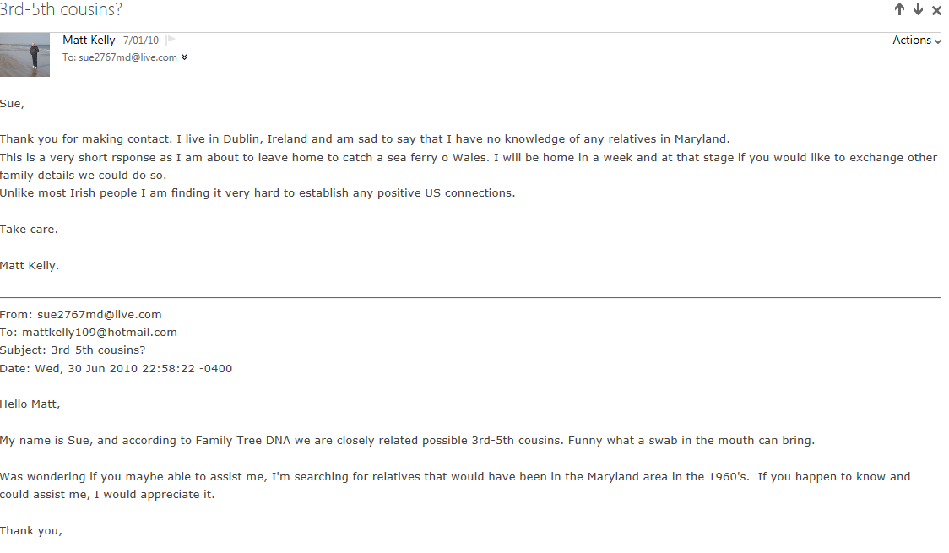
Finding Sue

Slide 15
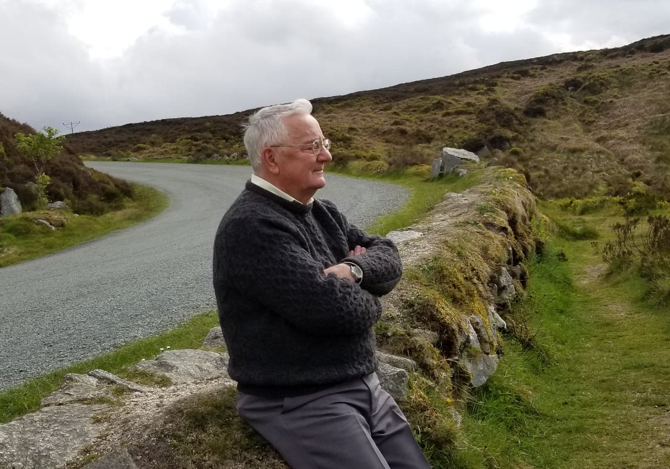
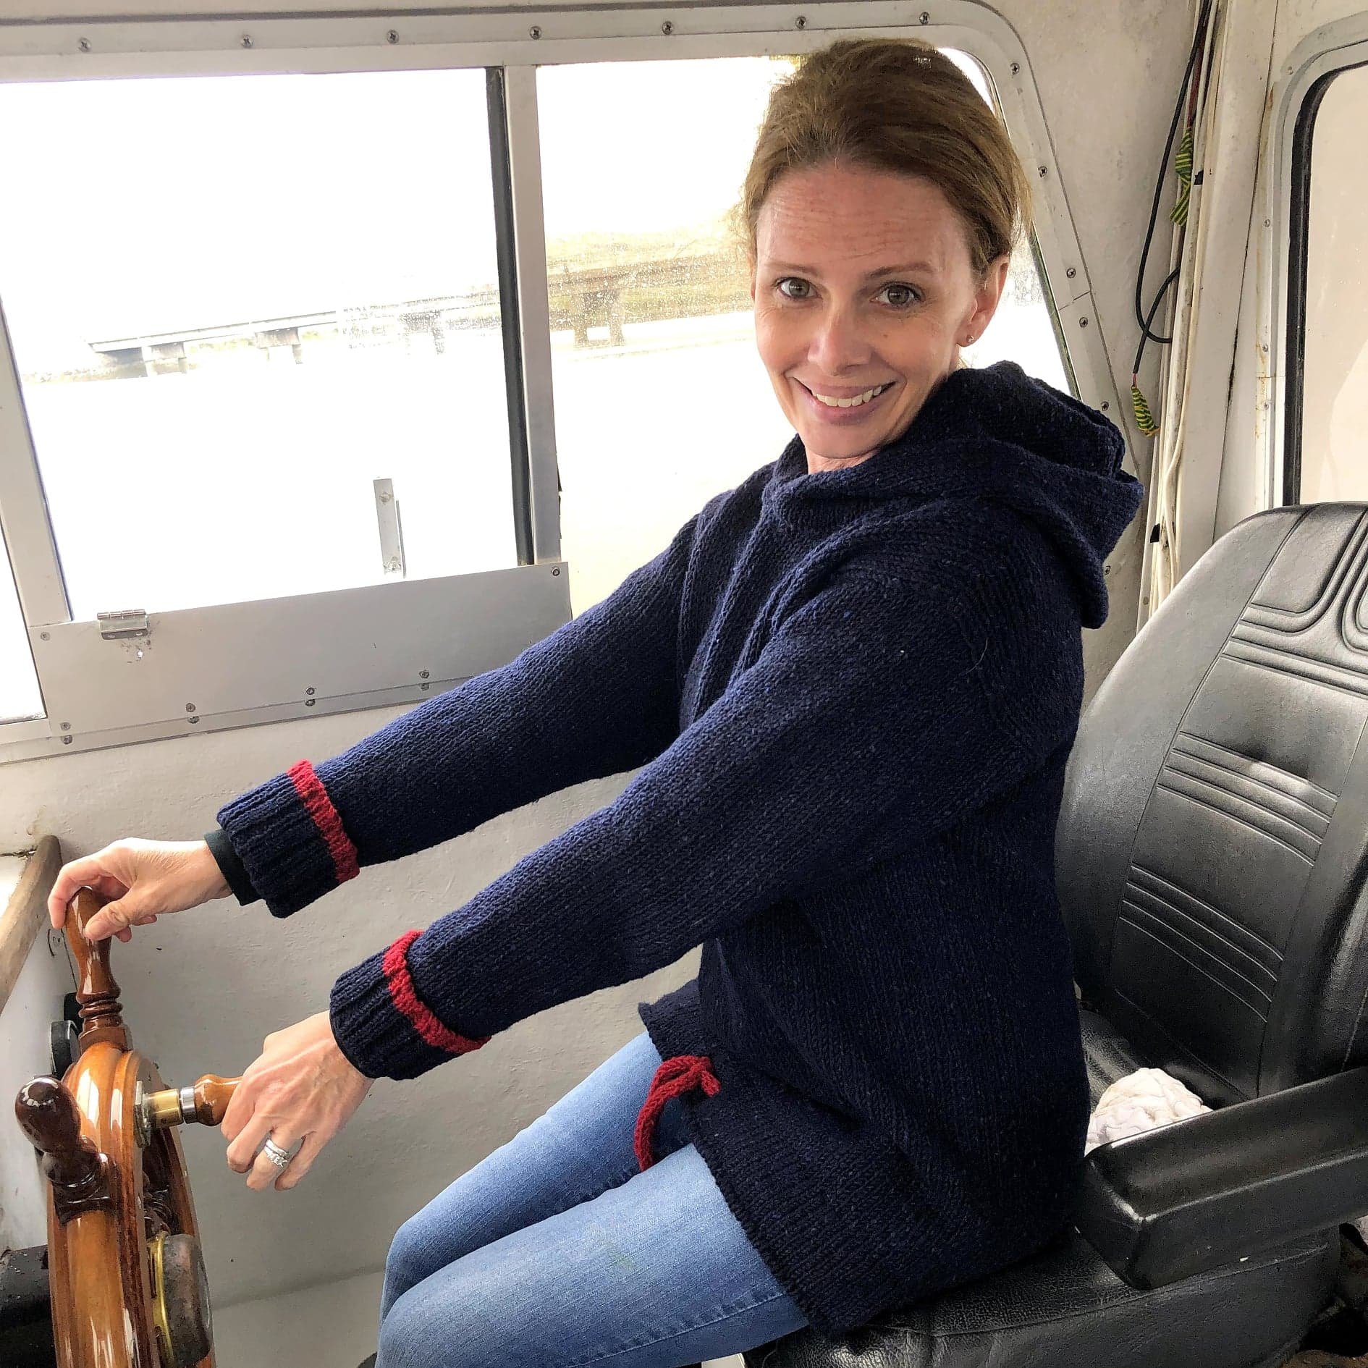
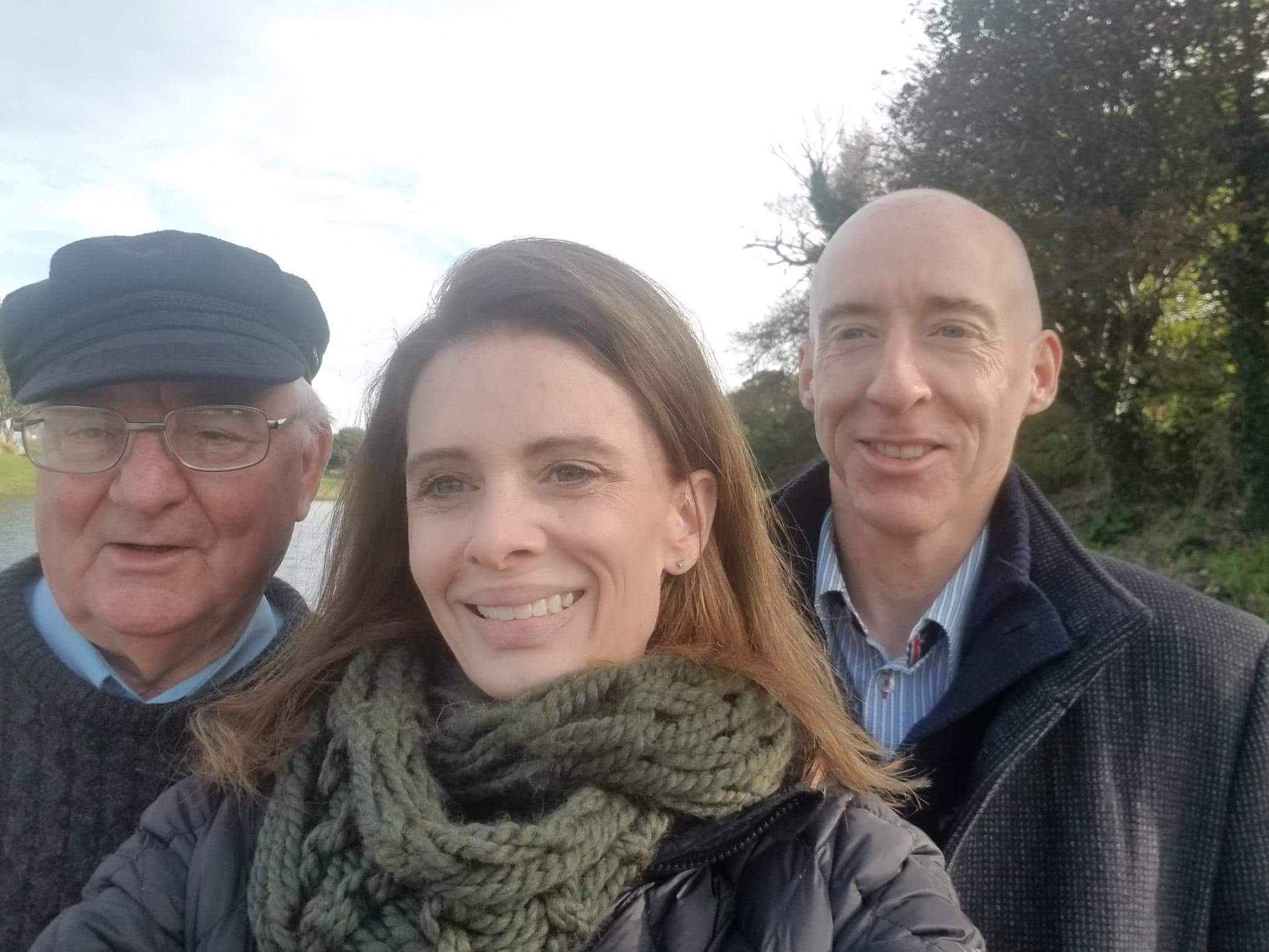
Finding Sue

Slide 16
Preparing
What do you know about this missing ancestor
Where did they live?
When did they live?
Who did they live around

Slide 17
Finding Common Ancestors – Original Theory
Find a match’s tree to start to hang your hook (aka Mirror Tree)
Work that tree back
Bring the tree forward
Find a new place to hang your hook
Make sure to keep track of what lines you’ve worked through.

Slide 20
1

Slide 21
2
1

Slide 22
3
2
1

Slide 23
4
3
2
1

Slide 36
0) Preparation:
DNAGedcom Client Ancestry Download
DGC FTDNA Download & Sync
DNAGecom GEDmatch Download
GEDMatch Matching Segement Search
GEDMatch Triangulation
Kitty Cooper &
OVERVIEW & SUMMARY
1) Identify a match of interest to investigate:
GEDmatch one-to-many
GEDmatch one-to-one
GEDmatch X one-to-one
2) Identify matches that are In-Common-With (ICW) your match of interest:
GEDmatch A-Matrix
GEDmatch People Who Match Both Kits
DNAGedcom CLM
DNAGedcom CMA
GEDmatch Triangulation Groups
3) Search the trees of your match of interest and ICW matches for a Common Ancestor:
DNAGedcom People
DNAGedcom People indicated “Tool” is a common surname in Middle Cousin’s (2) & Distant Shared’s (3) Tree
Dusty Tool is the ancestor of Middle Cousin (2), you discover she is the daughter of Broke & Bent Tool who are Distant Shared’s (3) ancestors
2
U
1
3
2 = Name: Middle Cousin
70cM / 4 segment
Tested at ancestryDNA
1 = Name: Big Match
289cM / 47 segments
Tested at 23andMe
3 = Name: Distant Shared
27cM / 1 segment
Tested at FTDNA
Has GEDCOM at GEDmatch
Has tree at ancestry
No GEDCOM at GEDmatch
No GEDCOM at GEDmatch, parents in tree at FTDNA
(You build tree and upload GEDCOM)

Slide 37
Finding Common Ancestors – New Theory
Find Cluster of Matches and their common ancestor
Use these as “Hooks” and use Probabilities to identify other potential lines

Slide 38
DNAGedcom
Allows you to Gather data from Ancestry, FTDNA, GEDmatch, My Heritage and 23andMe
Compare common ancestors from your matches with the DNAGedcom Client
View common ancestors of your matches through the Collins Leeds Methodology
View common Ancestors at the Chromosome Level through the Chromosome Matrix

Slide 39
DNAGedcom Collins Leeds Method
Clusters of Matches
Shows Leaf when two matches have a common Ancestor
Go to Tree directly from Cluster page

Slide 40
DNAGedcom CLM

Slide 41
DNAGedcom CLM

Slide 42
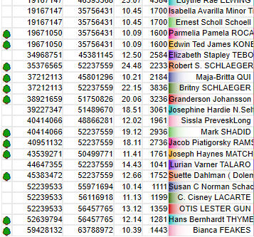
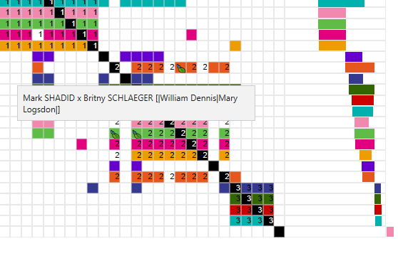
DNAGedcom Chromosome Matrix App (CMA)
Shows ICW and Segments in one seamless tool
Includes Common Ancestors between the two matches ON the chromosome browser
You can see matches that overlap but don’t match

Slide 43
DNAGedcom Kits

Slide 44
DNAGedcom Matches

Slide 45
DNAGedcom Match / Chromosome Browser

Slide 46
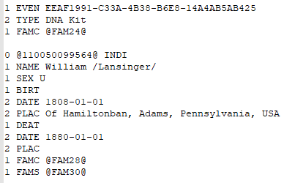
DNAGedcom People

Slide 47
Genetic.Family
Chrome Extension that adds Tags to every DNA company Web site
Allows you to see data from other companies together
Tag matches at a Tree level and rollup to DNA Painter
Share DNA data in a Project with other matches

Slide 48
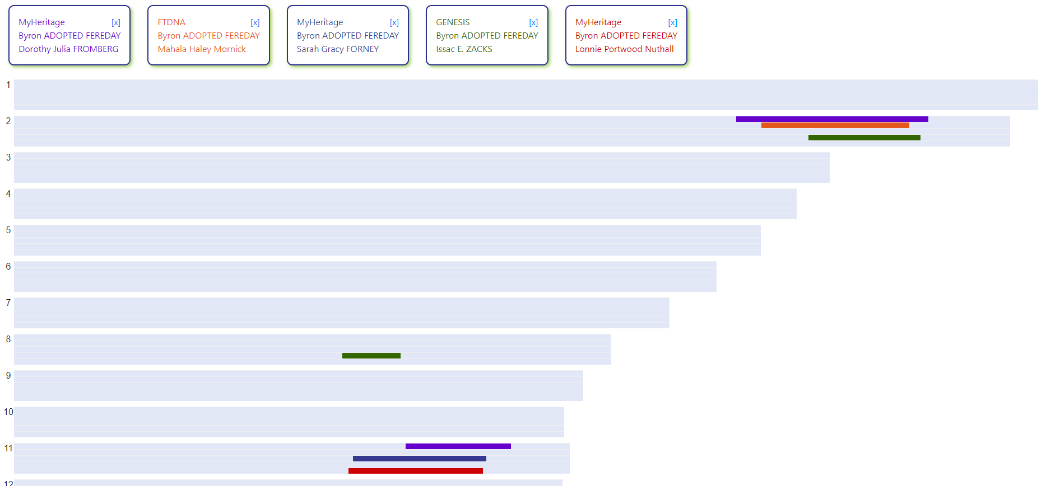
Genetic.Family

Slide 49
Genetic.Family Tag Tree Export to DNAPainter

Slide 50
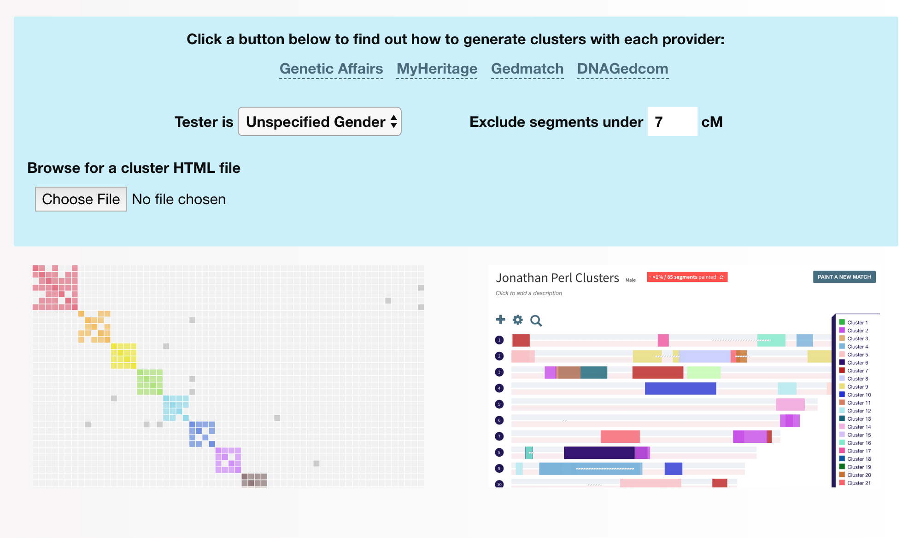
DNAPainter Cluster AutoPainter
Generate a chromosome Map with the segments grouped by cluster
Annotate your clusters of interrelated matches

Slide 51
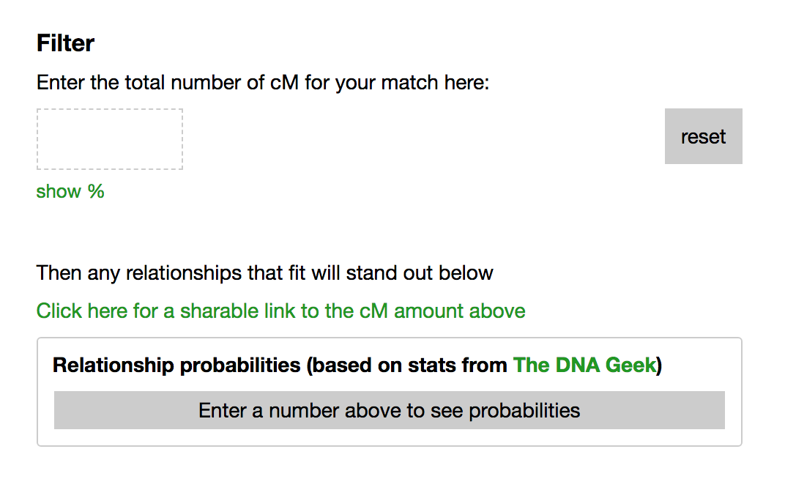
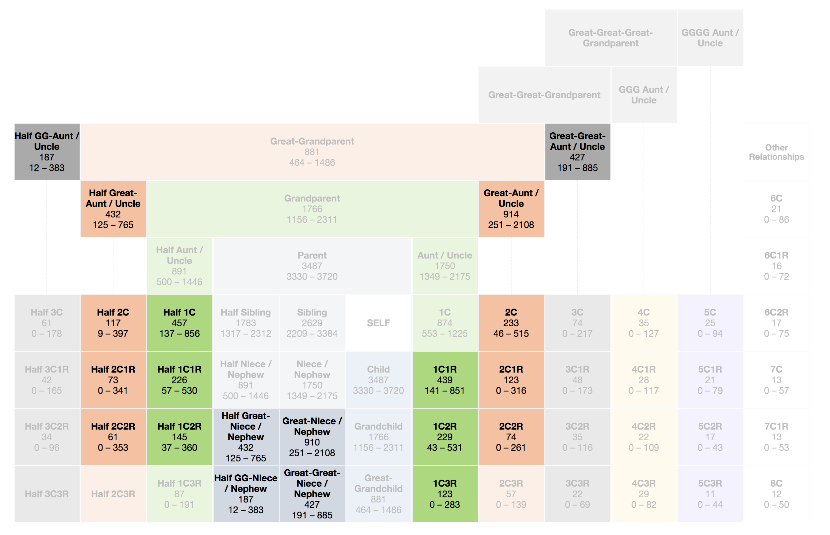
DNAPainter Shared cM Tool
WATO

Slide 52
Charting Companion
Charting Companion allows you to look at your family trees in many unique ways
Charting Companion has a DNA Simulation that allows you to simulate how an unknown match might fit into the tree.
DNAGedcom Client will soon allow a direct Export in Charting Companion
For now, check out “How to integrate genetic tree and FamilySearch tree” at 6:30 Today at the DNA Basics Booth in the Expo Hall

Slide 53
Charting Companion: Descendant Chart DNA Matrix
A B Fleming
C R Benson
K E Benson
DNA kit
T W
Stoddard
R A Benson
M F T
Littlejohn
C L Benson
M E
Whitwood
D Stoddard
DNA kit
K O
Stoddard
DNA kit
I M
Einzinger
C E Stoddard
J Yancey
R A Montes Littlejohn
D T DeLange
L D Benson
DNA kit
B Wellington
C M Benson
A W Gardner
Private (---)
C R Benson
Private (---)
S I Einzinger
DNA kit
R M-N
Lycurgue
K A
Einzinger
DNA kit
D A Stoddard
DNA kit
T DeLange
DNA kit
S Benson
DNA kit
N Gardner
DNA kit
W Gardner
DNA kit
M B Benson
DNA kit
D Kohn
DNA kit
L L Einzinger
DNA kit
1900 cM 100% H-Brother
930 cM 98% 1C
866 cM 97% 1C
694 cM 49% 1C
3463 cM 100% Father
1912 cM 100% Uncle
1749 cM 100% Uncle
1379 cM 74% Uncle
1373 cM 74% Uncle
525 cM 90% 1C1R
99 cM 4% 2C
413 cM 75% 1C1R
212 cM 46% 2C
333 cM 43% 1C1R
187 cM 38% 2C
787 cM 85% 1C
307 cM 33% 1C1R
3462 cM 100% Mother
1646 cM 100% gMother
2110 cM 86% gMother
768 cM 85% gAunt
1636 cM 100% Aunt
766 cM 85% gAunt
752 cM 85% gAunt
586 cM 11% gAunt
833 cM 95% gAunt
614 cM 23% gAunt
1028 cM 100% ggDaughter
236 cM 52% 1C2R
50 cM 4% 2C1R
1970 cM 100% gSon
445 cM 84% 1C1R
235 cM 52% 2C
3471 cM 100% Daughter
849 cM 95% 1C
171 cM 1% 1C1R

Slide 54
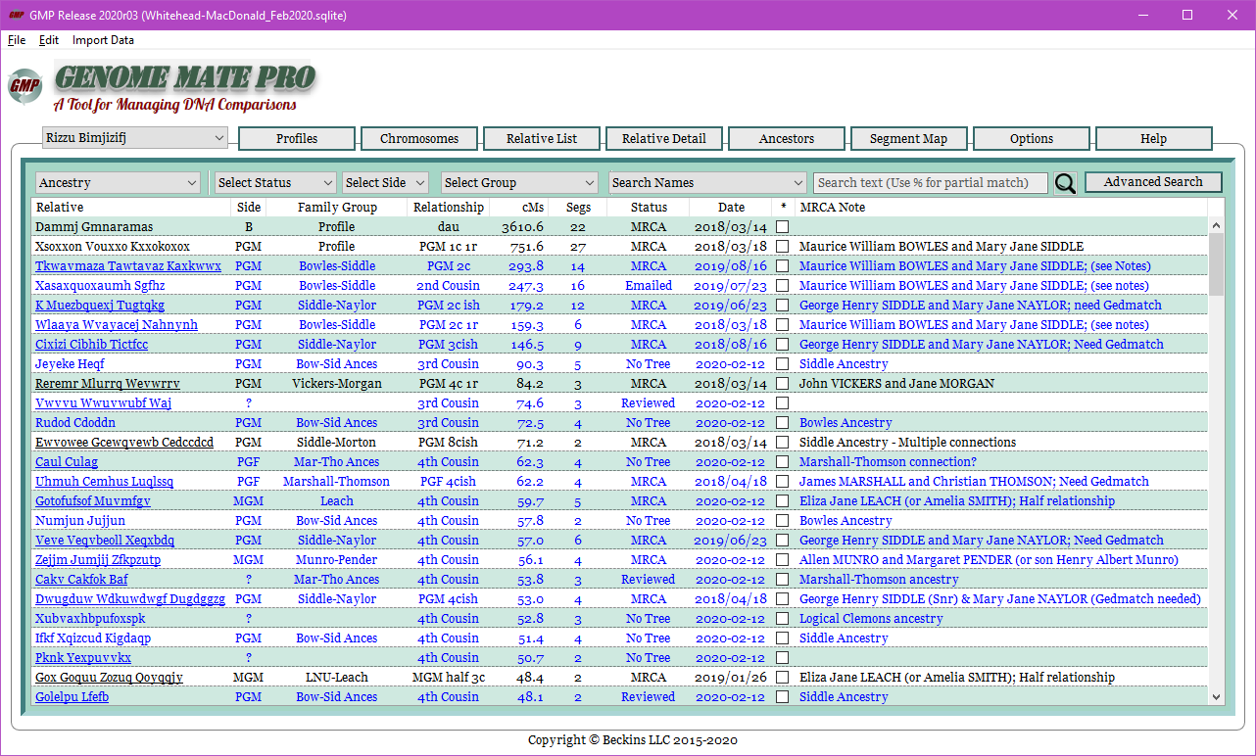
Genome Mate Pro

Slide 55
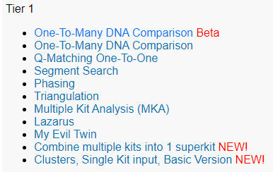
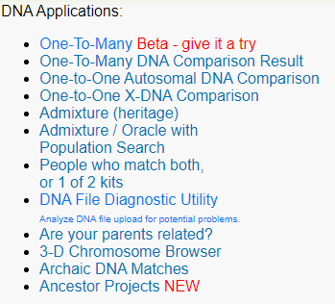
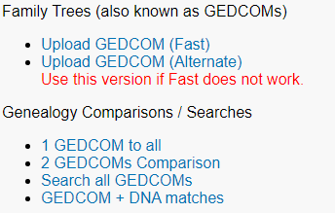
GEDmatch

Slide 56
Borland Genetics
Autosomal Matching Site
Has DNA Profiles built from others to “Resurrect” older ancestors
Match to an ACTUAL common Ancestor

Slide 57
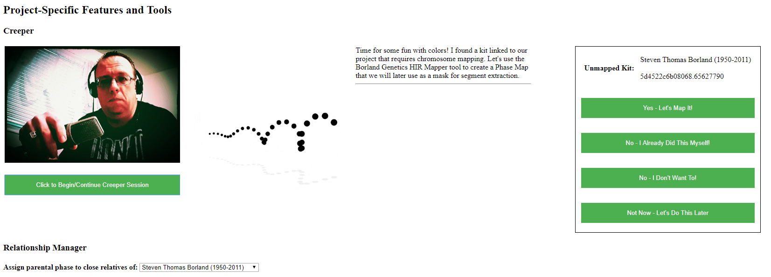
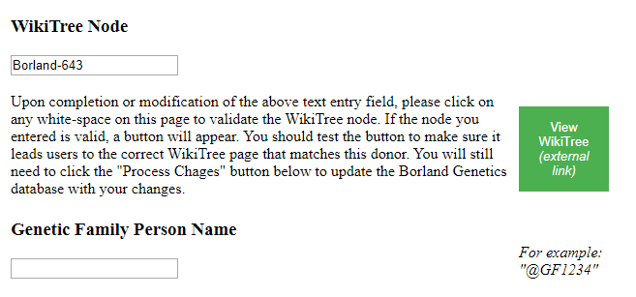
Borland Genetics

Slide 58
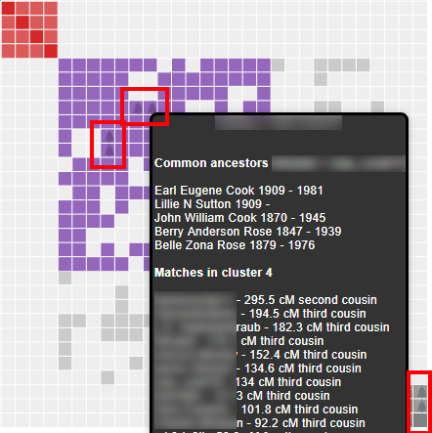
Genetic Affairs
AutoCluster groups together DNA Matches that likely descend from common ancestors in a visual chart
AutoTree available for Ancestry and FTDNA
Common locations using clustering of GPS coordinates of birth locations
Works with Ancestry and FTDNA

Slide 59
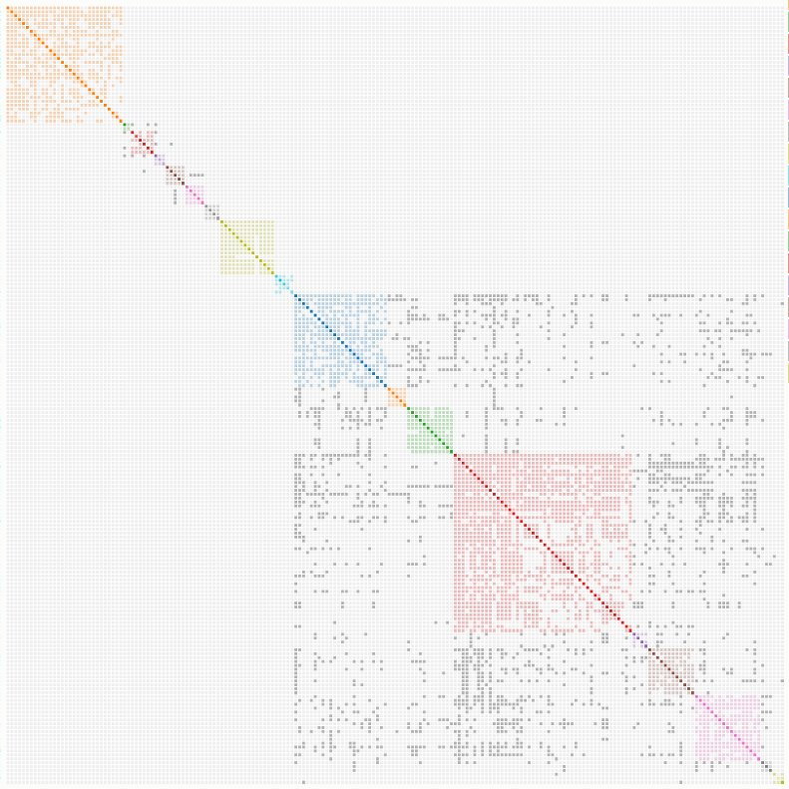
Genetic Affairs

Slide 60
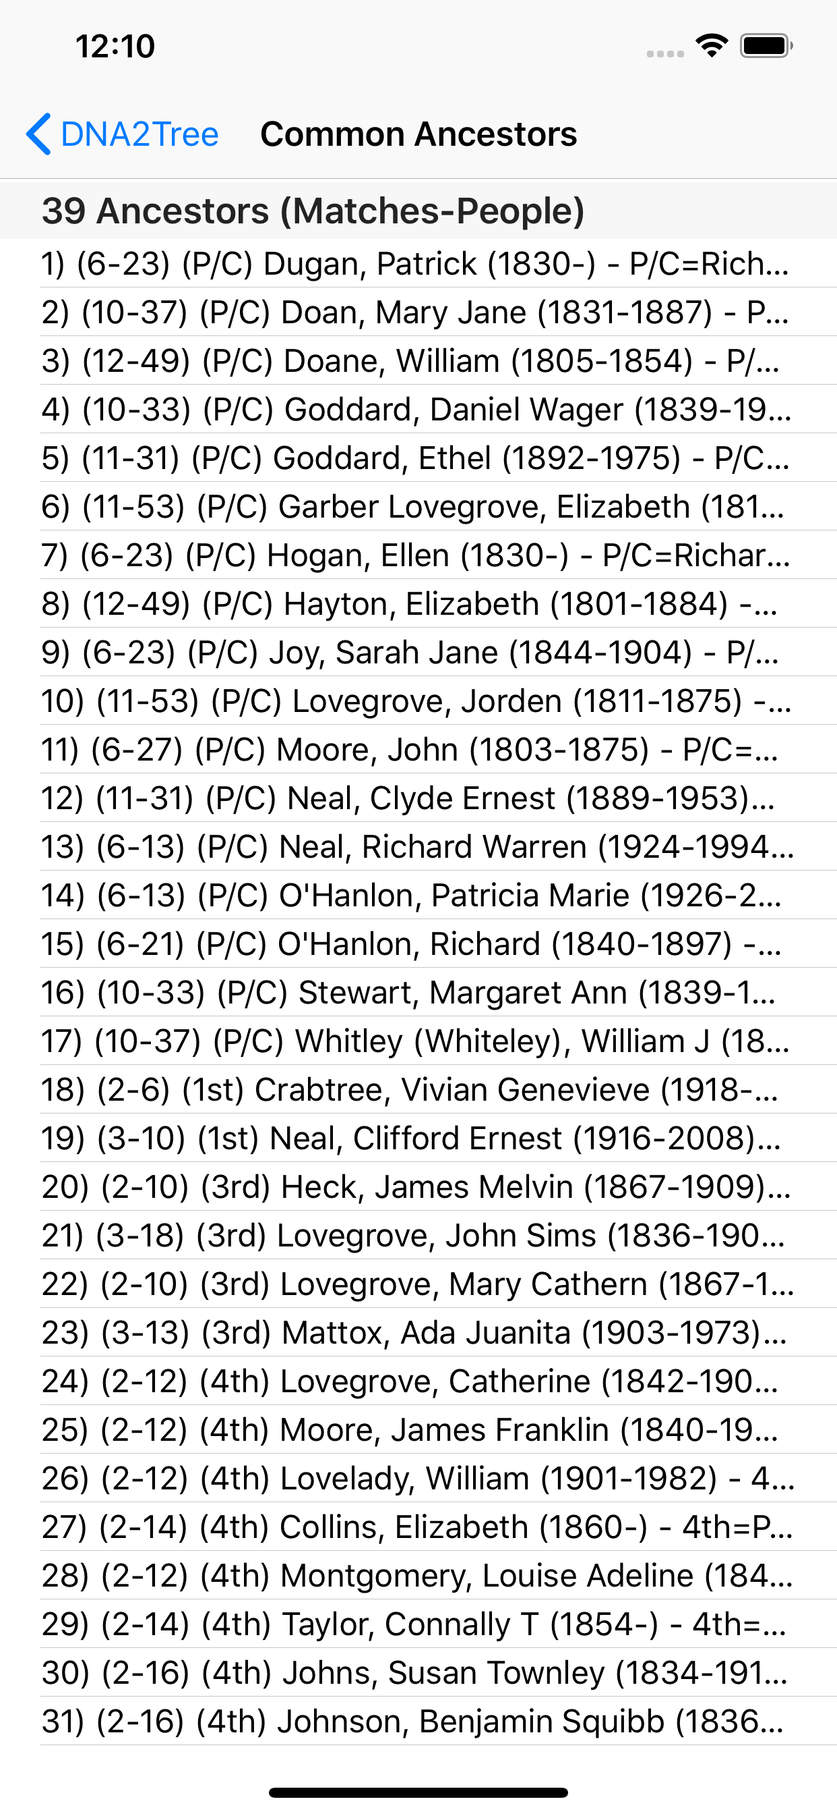
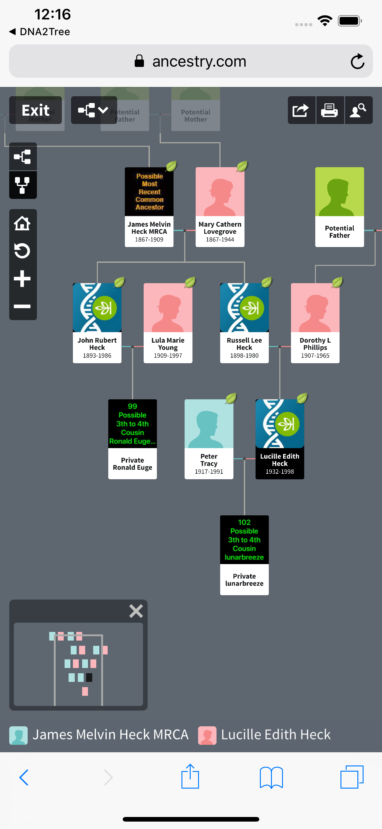
DNA2Tree
Loads closely related Matches
Finds Common Ancestors of those matches
Builds out a Birth Family Tree and pushed to Ancestry
Only works with Ancestry

Slide 61
mitoYDNA
A Y and mitochondrial DNA Database - Crowdsourced, Free and Accessible

Slide 62
mitoYDNA
Works with mtDNA and YDNA
Provides tools to help you find other matches on your straight Paternal or Maternal line
Matches mtDNA and YDNA from various companies.

Slide 63
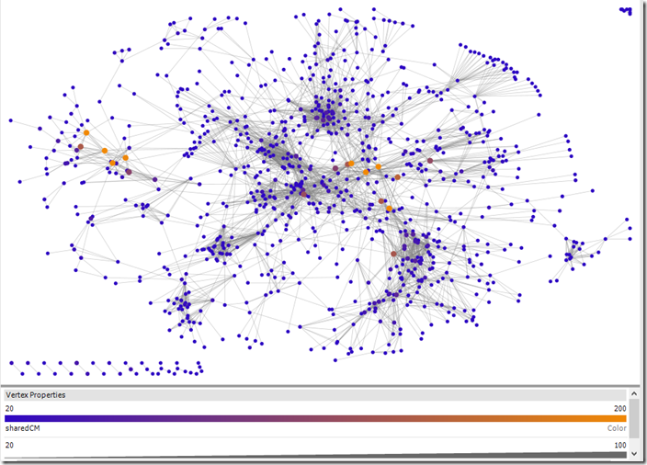
Shelley Crawford’s Twigs of Yore
Based on Excel Add in NodeXL
Find it at http://bit.ly/TwigsDG (https://twigsofyore.blogspot.ie/2017/07/visualising-ancestry-dna-matchesindex.html)

Slide 64
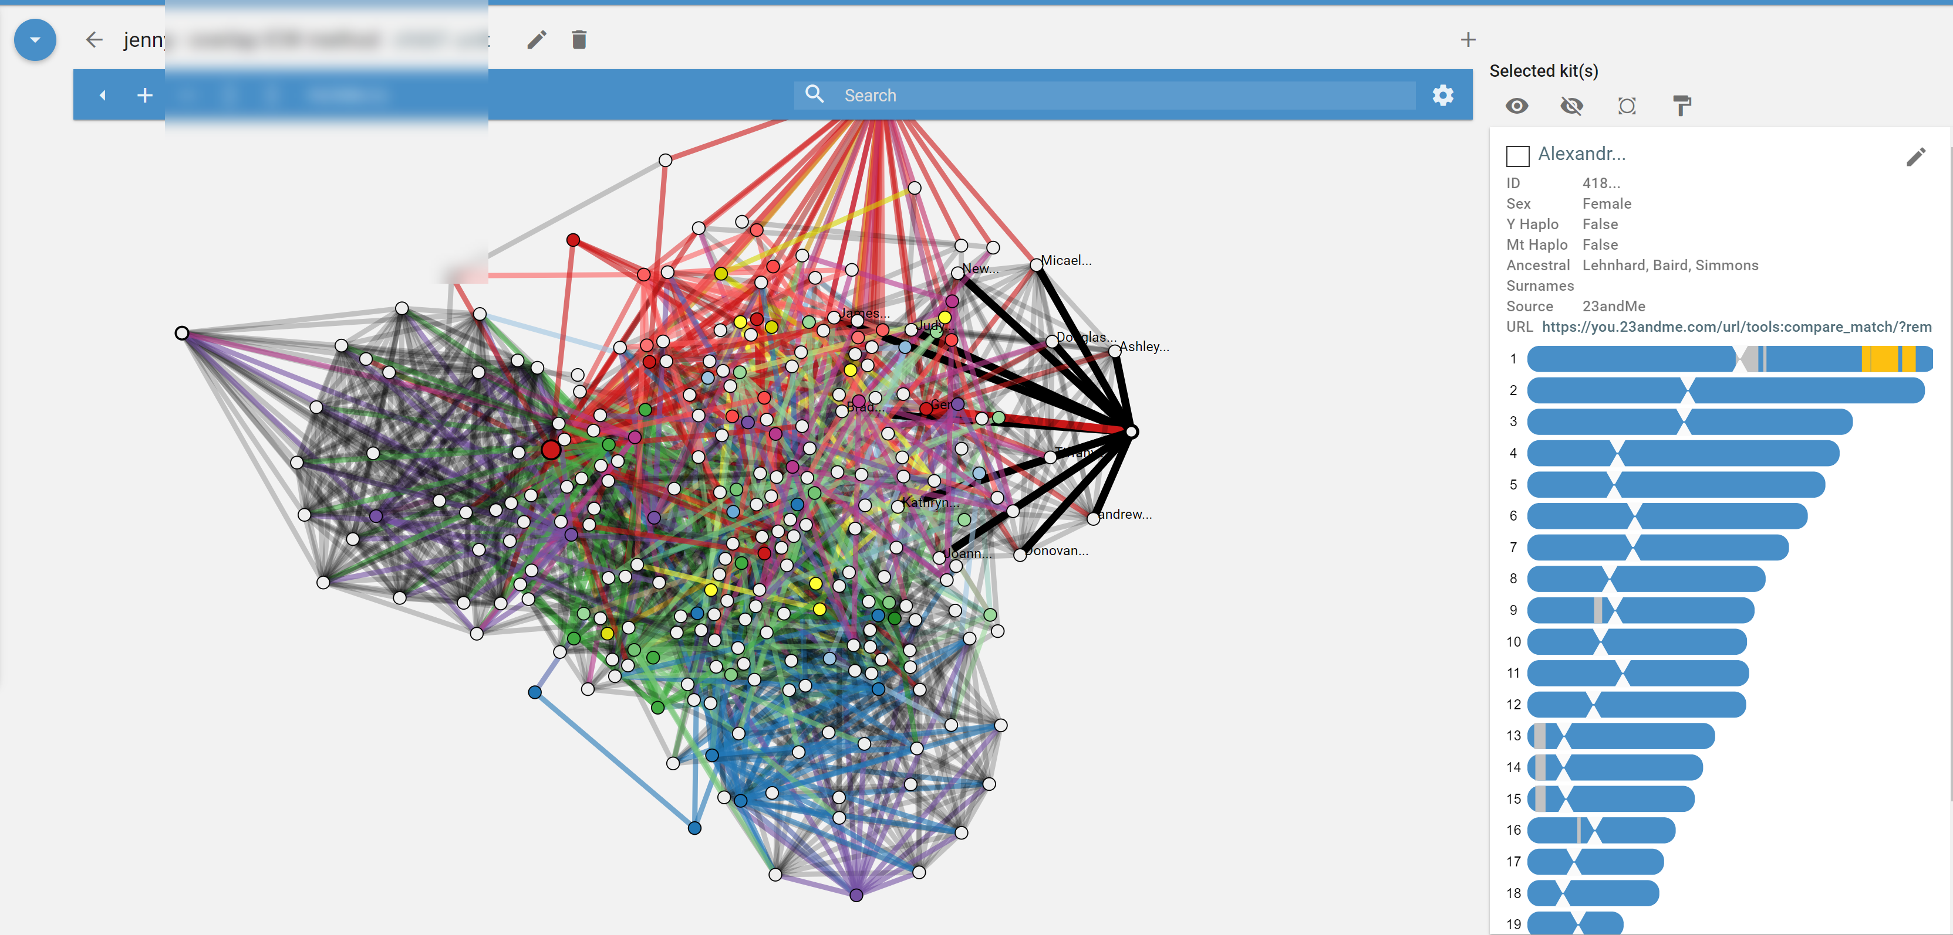
RootsFinder
Matches are tagged by specific ancestral line
Provides nice Network Graphs
Provides Circle Graphs
Different ways of looking at the data

Slide 65
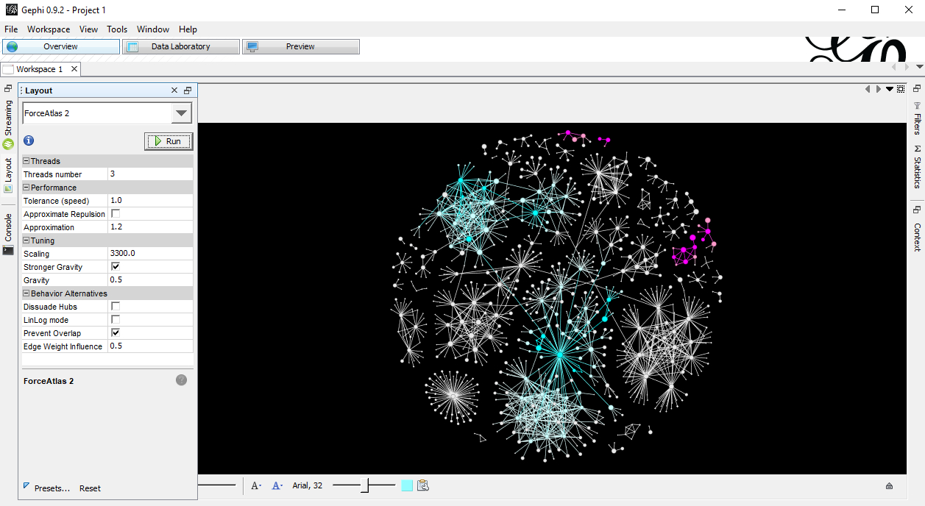
DNADNA

Slide 66
What did we know?
Sue’s Adoption paper says Baby Girl Gregg
Finding Female Gregg
Birth Mother’s father died from a particular cancer
Since we knew that when she was born, we know he died before her birth (Deduce information from other information)

Slide 67
DNA Hints
Popular Surnames
Clemmons, Palmer, Moore, Marriott, Swann
Places
Scotland -> Ireland -> Delaware
Strong Irish Ties (Father?)

Slide 68
Find our Own Match
C. Gregg
Sister was right age
Sister had passed (so we can’t ask her or have her test)
Sister’s son lived down the street from us. Hmmm
Sister’s Widow Husband lived across the street from us at new house

Slide 69
MATCH!!!
Note the X Match of 10 cM

Slide 70
Interesting Tree

Slide 71
Targeted Testing
Found someone approachable who was somewhat related
Asked them to test.
Results?

Slide 72
What about Father’s side
What did we know?
Father was in Maryland about 9 months before Sue was born.
AND
Not
Much
Else

Slide 73
What about Father side
From ASDA (Precursor to CMA)
Known Maternal Match

Slide 74
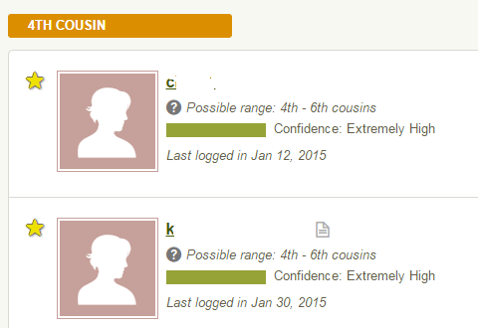
Where to start?
Ancestry DNA Helps out (a bit)
GEDMatch to the Rescue (some)
23andMe has some interesting “3rd” cousin match (probably not that close)
FTDNA has some more distant matches
Need to Build out Tree

Slide 75
Hanging My Hook
Through the GWorks tool (now part of DNAGedcom People), was able to find some common ancestors.
Back then I had to build these trees by hand.
This is helpful because it helps you learn and understand the data better
This is TIME consuming, so automation is nice
Started seeing patterns

Slide 76
Great Great Grandparents?

Slide 78
West
Remember that “Where”?
Everyone was moving and staying west
No one had family staying in Maryland.
Dead End

Slide 79
DNAGedcom People Viewer
Using Surname Search
Pay attention to places and surnames
Build down children
Add Spouse
Build up the Spouse
Spouse matching any Surnames?
Using Comparison
Upload Compare Tree
New matches?
Concentrate on Close matches

Slide 80
Step Back
So I had to step back more.
Remember that “3rd Cousin”? Didn’t end up being that close.
After working back one more branch, moved them forward.
Look what I found…
Family moved West (Well Ohio)
Then back East to …..
MARYLAND

Slide 81
Is it him?
In our case, we did have some other Hints.
DNA doesn’t tell the whole story.
Hints make this very possible. How do we figure it out for sure?

Slide 82
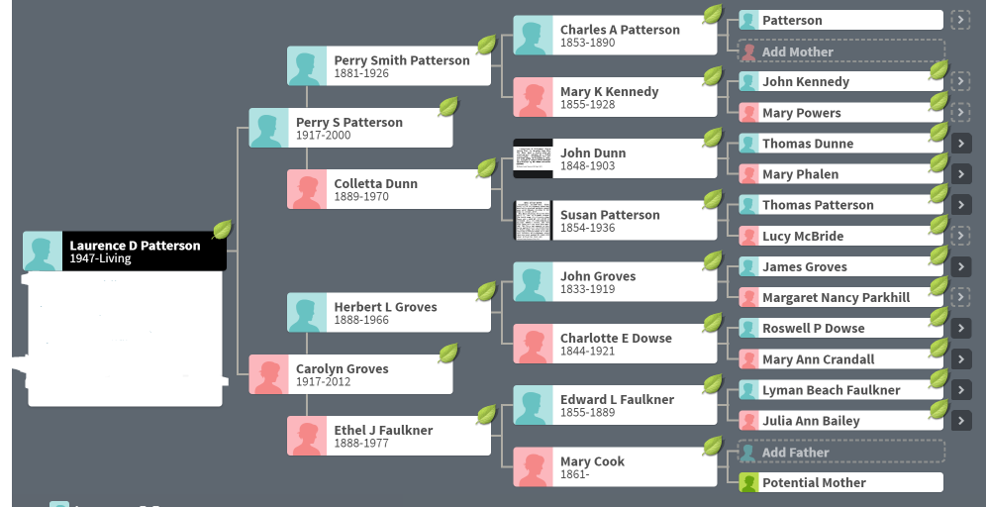
Putting it together?
23andMe 3rd Cousin Once Removed
Ancestry 4th Cousins
FTDNA Misc Distant Matches

Slide 83
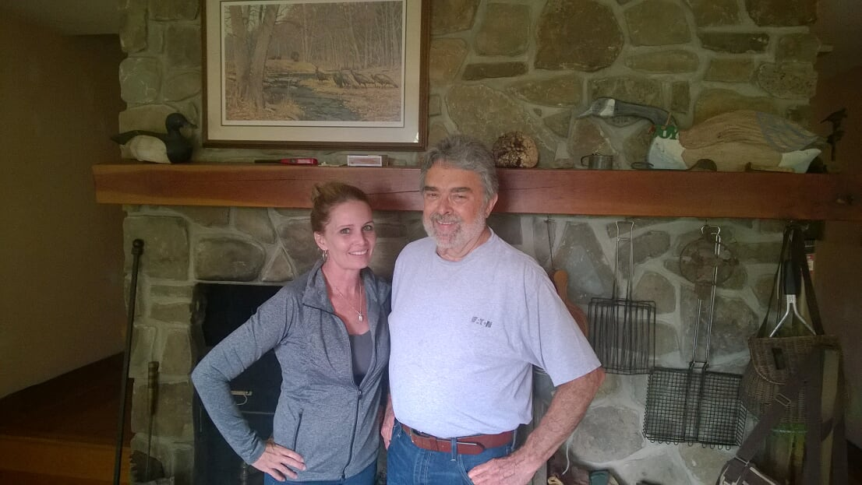
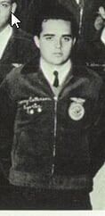
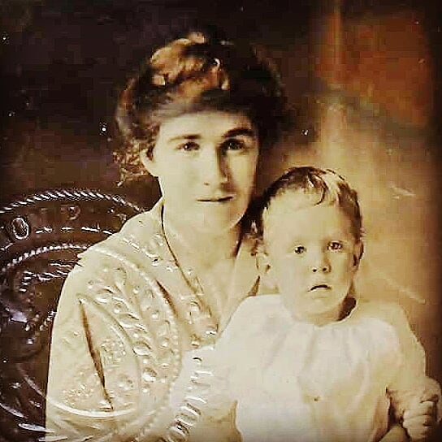
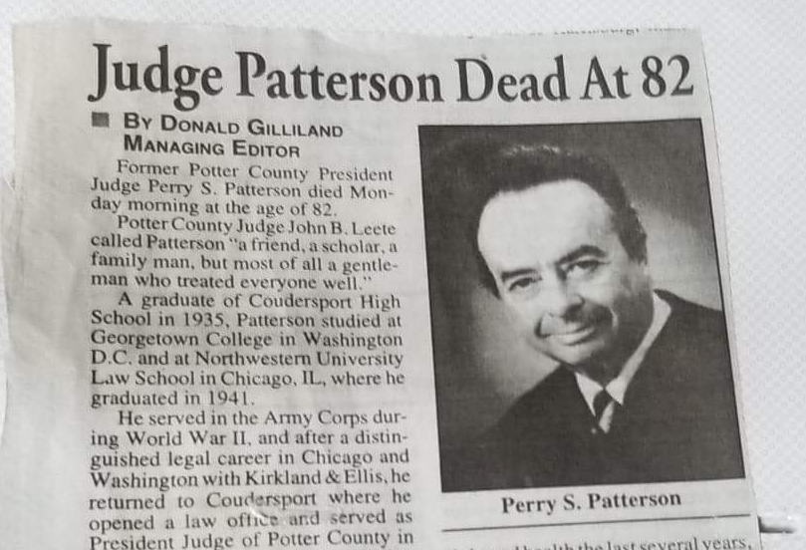
Biological Father Found through Common Ancestors

Slide 84
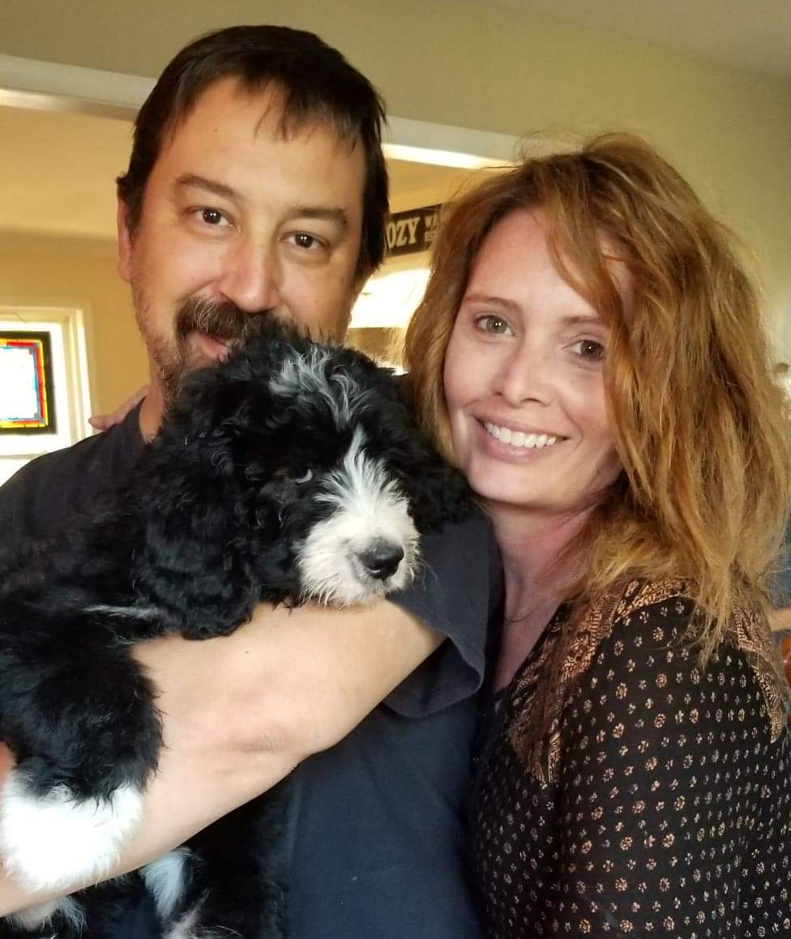
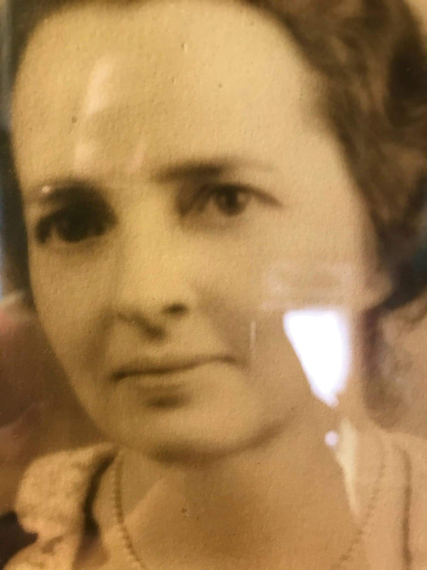

Slide 85
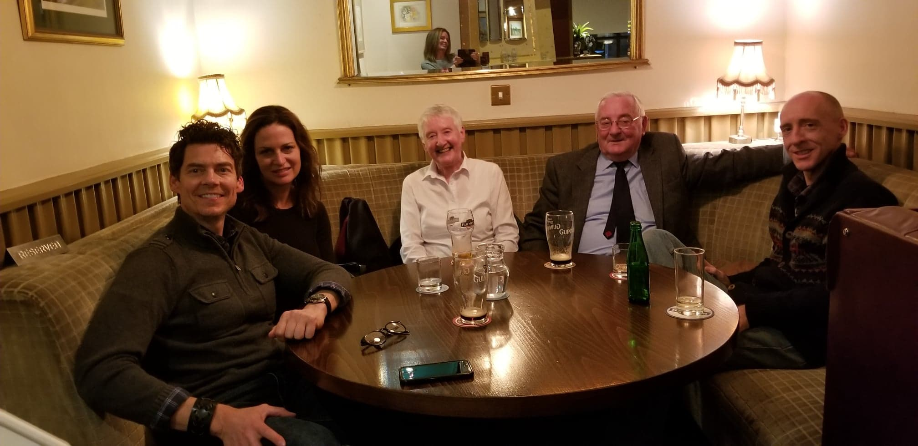
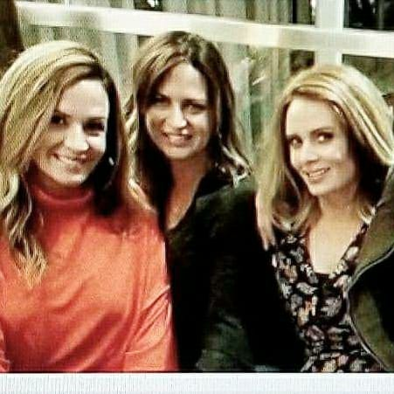
Start and Finish Meet

Slide 86
Thanks
DNAAdoption.org
ISOGG.org
Leah Larkin, theDNAgeek.com
Brock Waters
John Collins
Various Third-Party Tool Authors and Sites.

Slide 87
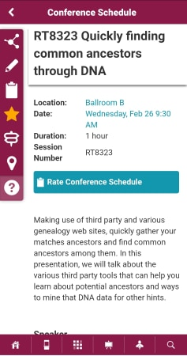
Feedback
Remember to give feedback in the app!
Go to session RT8323 in the RootsTech Mobile App
Tap the “Clipboard” icon
Rate the presentation

Slide 88
Presenter Contact Information / Questions
: rob.warthen@dnagedcom.com
: www.dnagedcom.com
: www.dnagedcom/doc
: www.facebook.com/DNAGedcom/
Exhibit Hall Booth 1545
(By RootsTech Store)

